Slide 1
GRU-DF: An RNN Model with Dynamic Imputation for Missing Values in Multivariate Time Series
By Matias Berretta
Advised by Yijun Zhao, Ph.D.

Slide 2

Multiple Sclerosis
Multiple Sclerosis
An autoimmune disease of the central nervous system in which the immune system attacks the myelin sheath (a fatty layer of substance protecting the nerves)
Patients suffer from various levels of disability
It is critical to predict the disease course at its early stage for the patients to receive the right treatments.

Slide 3
General Overview
GOAL Provide right treatment for patients
by predicting disease course
DATA Clinical dataset from Harvard Medical School
(Multivariate Time Series)
APPROACH Deploy temporal model for temporal
dataset using Recurrent Neural Networks

Slide 4
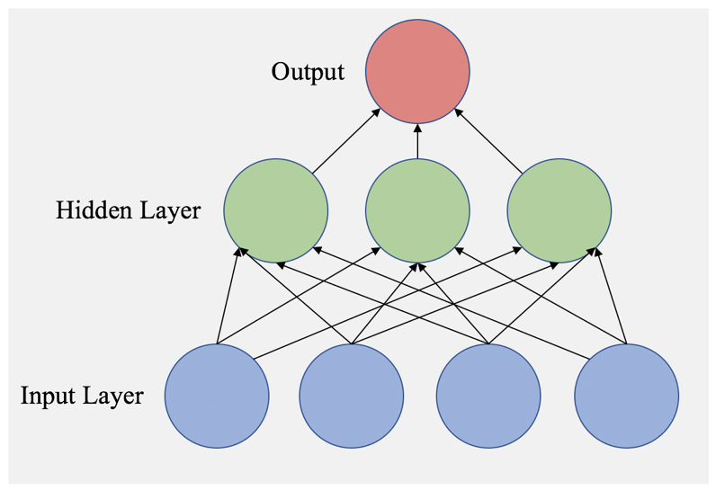
Neural Networks
Figure 1: A Feedforward Neural Network. An instance is presented to the network as values via the blue, bottom nodes. The values of the nodes in each layer are computed successively as a function of the prior layers until output is produced at the top layer.

Slide 5
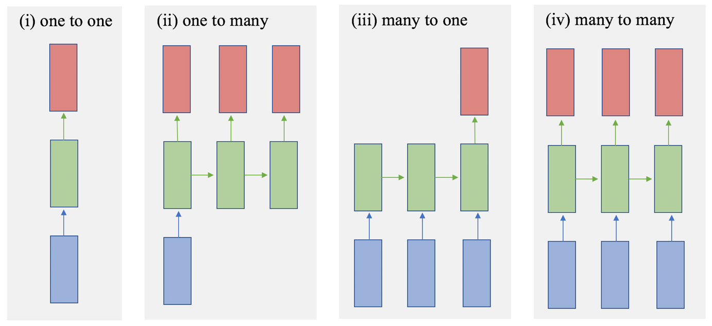
Mapping
Figure 2: RNN Input Output Mapping. Unlike regular neural networks, RNNs are particularly versatile when it comes to modelling input and output. An RNN can model any of the following input to output relationships: (i) one to one, (ii) one to many, (iii) many to one, (iv) many to many. For our paper we will be using (iii) many to one mapping, where the input is sequential data consisting of patient information across x years (observation window) and the output is the patient’s EDSS score y years into the future (prediction length).

Slide 6
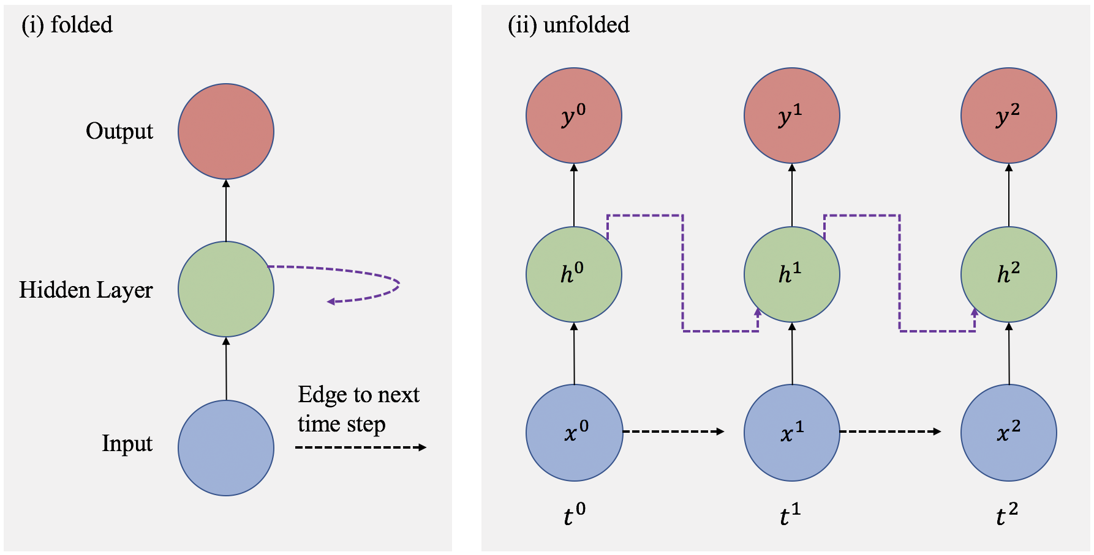
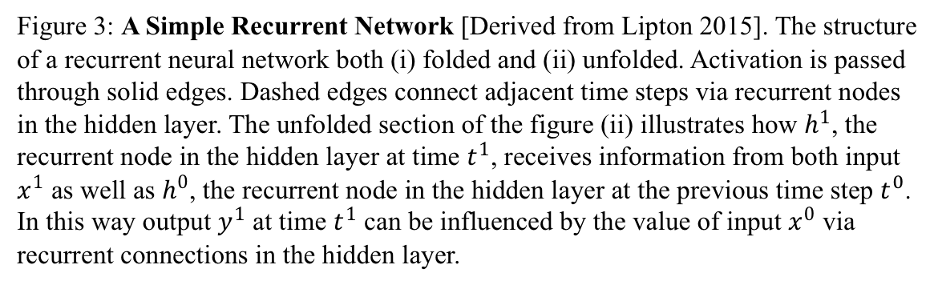
RNNs
Figure 3: A Simple Recurrent Network [Derived from Lipton 2015]. The structure of a recurrent neural network both (i) folded and (ii) unfolded. Activation is passed through solid edges. Dashed edges connect adjacent time steps via recurrent nodes in the hidden layer. The unfolded section of the figure (ii) illustrates how $h^{1}$, the recurrent node in the hidden layer at time $t^{1}$, receives information from both input $x^{1}$ as well as $h^{0}$, the recurrent node in the hidden layer at the previous time step $t^{0}$. In this way output $y^{1}$ at time $t^{1}$ can be influenced by the value of input $x^{0}$ via recurrent connections in the hidden layer.

Slide 7
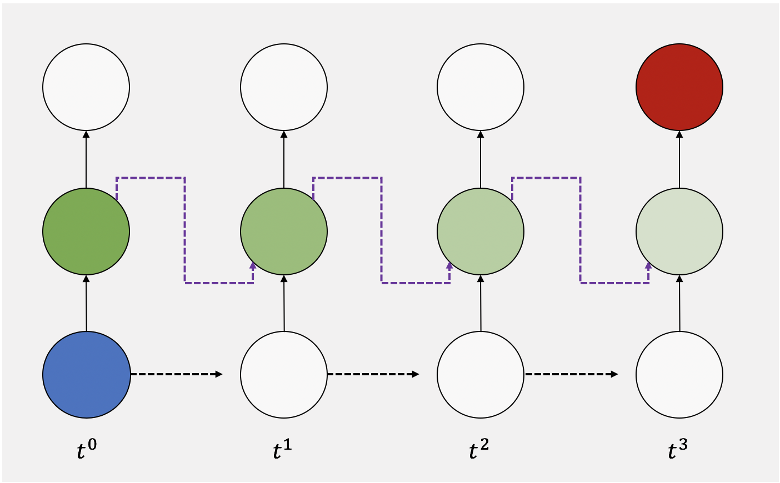
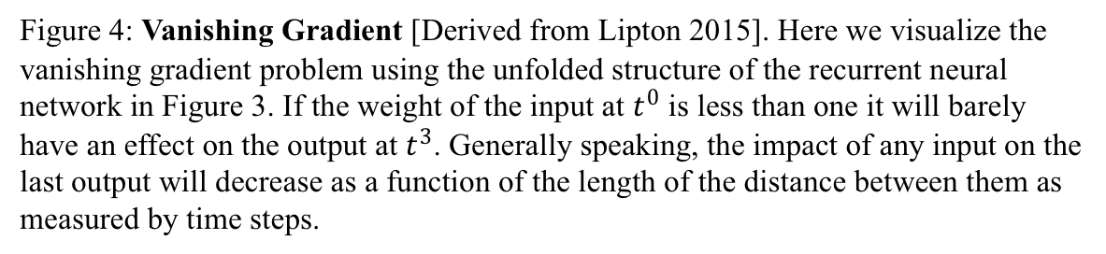
Vanishing Gradient Problem
Figure 4: Vanishing Gradient [Derived from Lipton 2015]. Here we visualize the vanishing gradient problem using the unfolded structure of the recurrent neural network in Figure 3. If the weight of the input at $t^{0}$ is less than one it will barely have an effect on the output at $t^{3}$. Generally speaking, the impact of any input on the last output will decrease as a function of the length of the distance between them as measured by time steps.

Slide 8
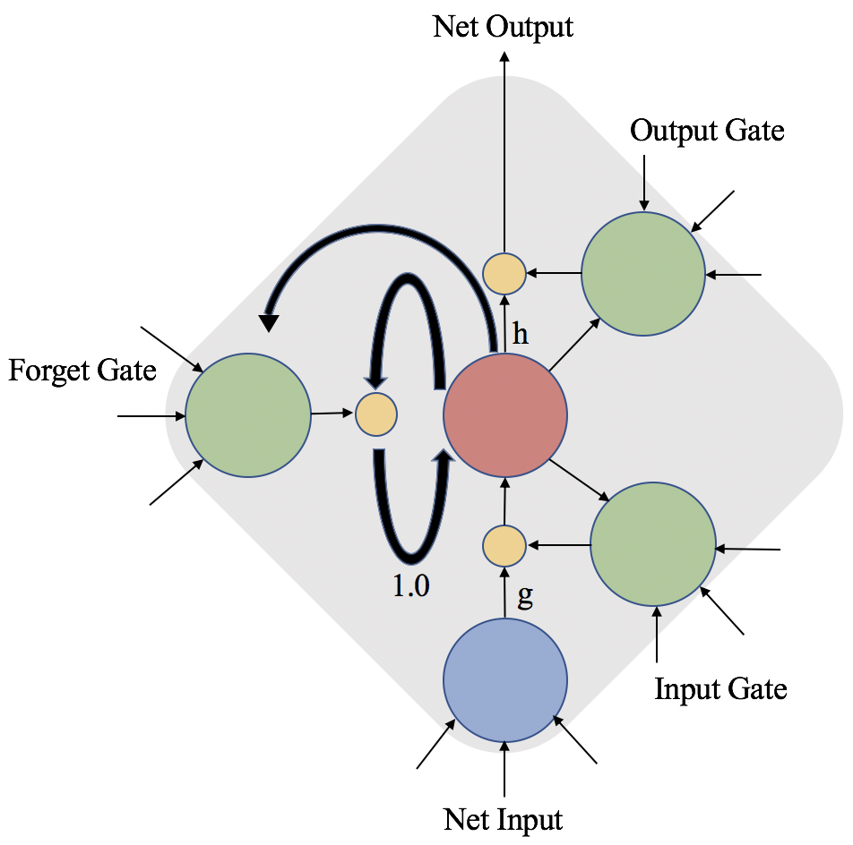
LSTM
Figure 5: LSTM Memory Cell [Derived from Graves 2012]. The internal state (red) is maintained by a recurrent connection of fixed weight 1.0. The three gates (green) collect activations from inside and outside the block, and control the cell via multiplicative units (small yellow circles). The input and output gates scale the input and output of the cell, whereas the forget gate scales the internal state. The cell input and output activation functions (g and h, respectively) are applied at the indicated places.

Slide 9
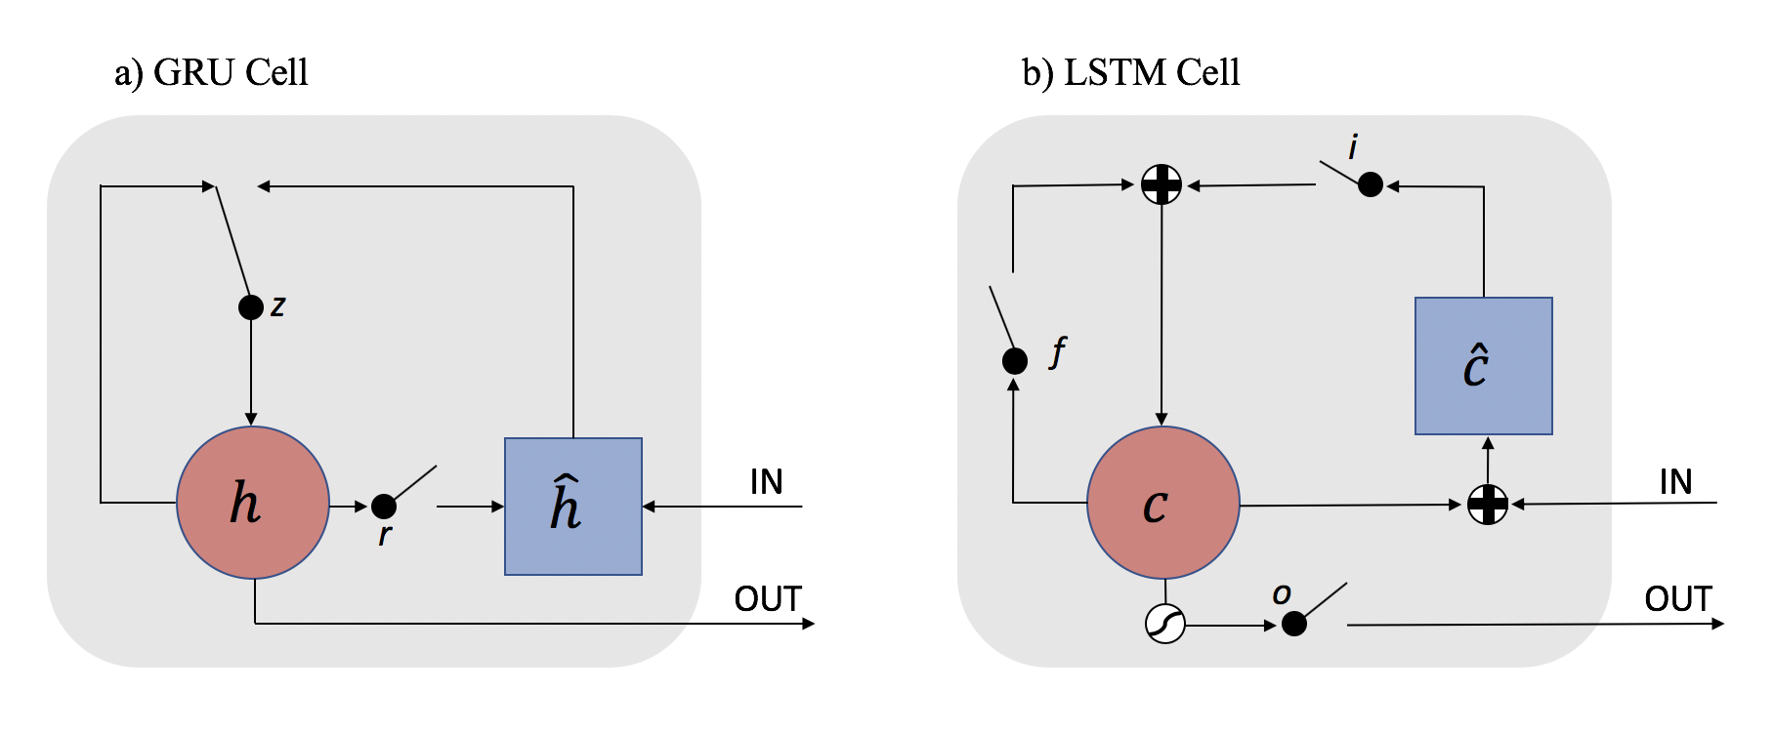
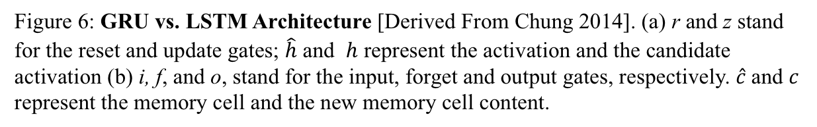
GRU
Figure 6: GRU vs. LSTM Architecture [Derived From Chung 2014]. (a) r and z stand for the reset and update gates; $\hat{h}$ and $h$ represent the activation and the candidate activation (b) i, f, and o, stand for the input, forget and output gates, respectively. $\hat{c}$and $c$ represent the memory cell and the new memory cell content.

Slide 10
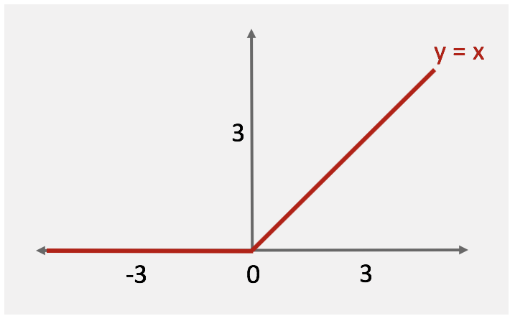
Activation Function
Figure 7: ReLu Activation Function. Visual representation of a ReLu activation function is outlined by red, dotted line. Negative values are set to zero, while positive values are treated linearly.

Slide 11
RNN TERMS
Time Step
Context Window
Observation Length
Prediction Length

Slide 12

DATA
Medical records on 508 patients taken every 6 months
(9 years)
Timed features
i.e. EDSS and BPF
Fixed features
i.e. Date of Birth and Gender

Slide 13

Target: EDSS Score
Expanded Disability Status Scale (EDSS)
Method for quantifying disability in multiple sclerosis
Scale from 0 to 1 rising in 0.05 increments
Regression Problem
Dense Layer at the end of RNN architecture outputs single EDSS value per time step
Rounded off to nearest 0.5 interval to fit EDSS scale

Slide 14
Reshaping
For the sake of the RNN we turn our data into 3-D Arrays
WHO (sequence/patient)
WHEN (time step)
WHAT (feature/target)
ARRAY[0][1][2]

Slide 15
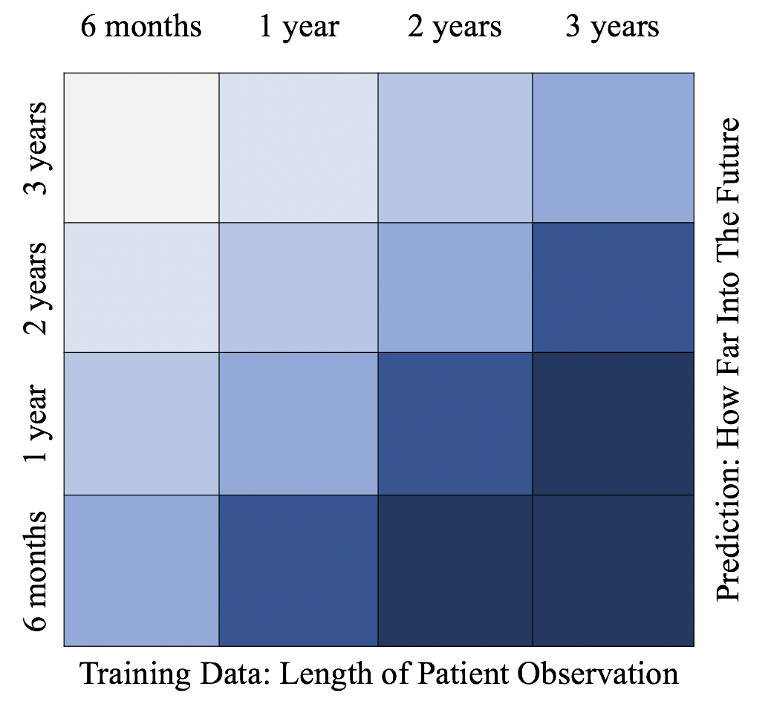
PREDICTION GRID
OBSERVATION LEN GTH
PREDICTION LENGTH
Figure 8: Results Grid. This figure illustrates what we set out to determine: given x amount of patient observation (x-axis), we evaluate the accuracy of predictions y amount of time into the future (y-axis), as evaluated by MAE, the value of which is represented by color, where the darker the hue, the better the MAE score.

Slide 16
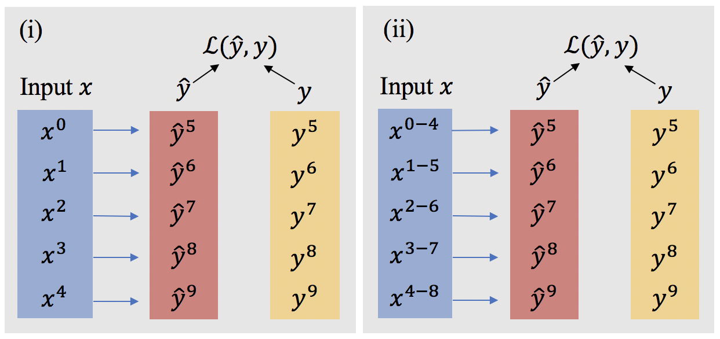
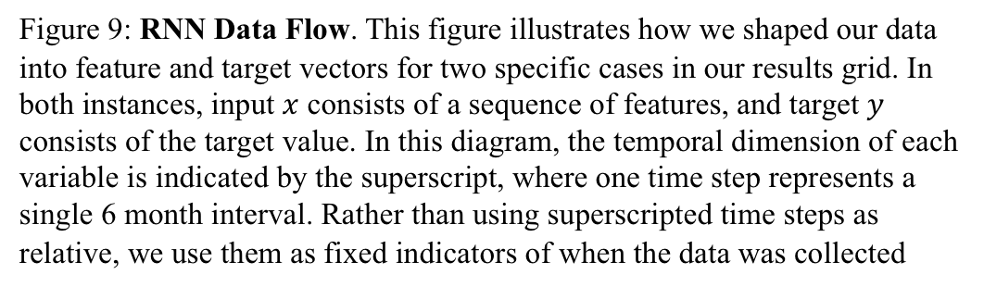
DATA FLOW
Figure 9: RNN Data Flow. This figure illustrates how we shaped our data into feature and target vectors for two specific cases in our results grid. In both instances, input $x$ consists of a sequence of features, and target $y$ consists of the target value. In this diagram, the temporal dimension of each variable is indicated by the superscript, where one time step represents a single 6 month interval. Rather than using superscripted time steps as relative, we use them as fixed indicators of when the data was collected

Slide 17
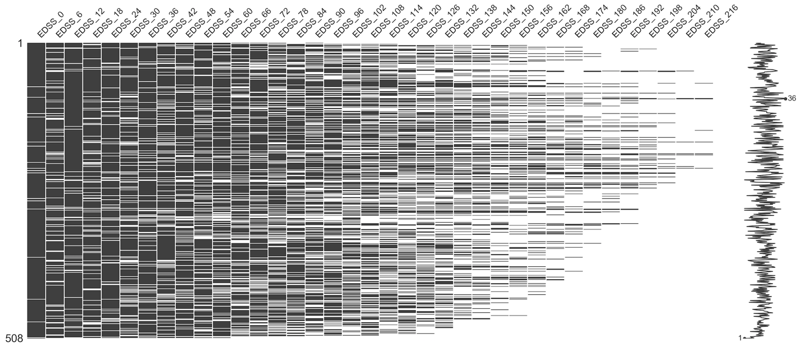
Missing Data

Slide 18
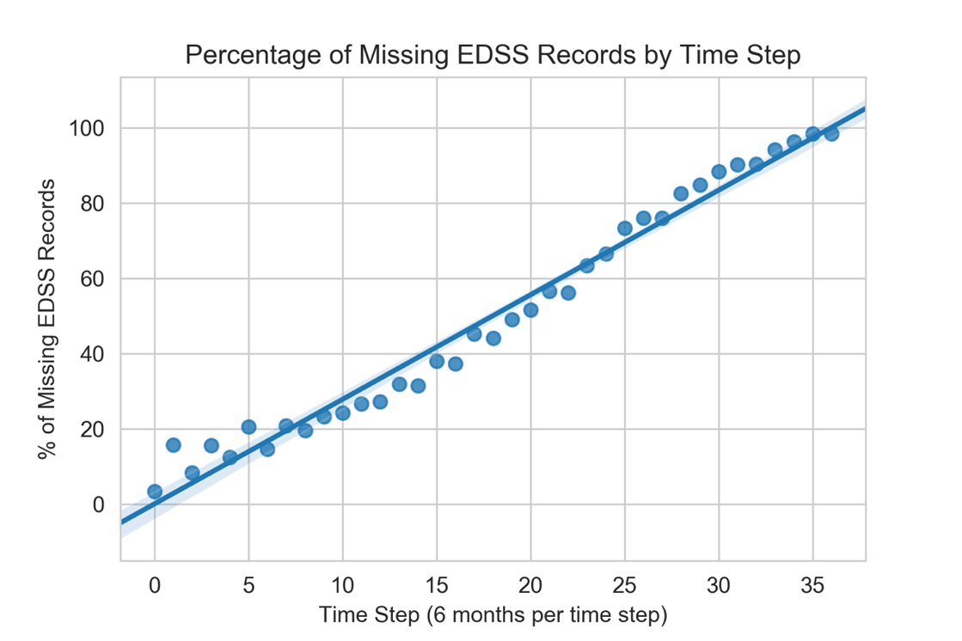
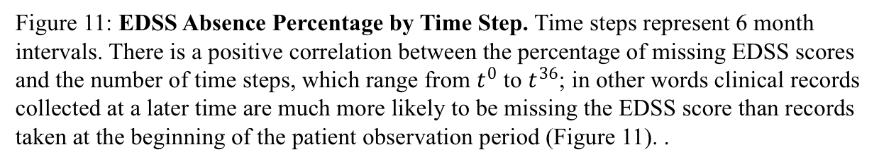
The farther we go the worse it gets
Figure 11: EDSS Absence Percentage by Time Step. Time steps represent 6 month intervals. There is a positive correlation between the percentage of missing EDSS scores and the number of time steps, which range from $t^{0}$ to $t^{36}$; in other words clinical records collected at a later time are much more likely to be missing the EDSS score than records taken at the beginning of the patient observation period (Figure 11). .

Slide 19
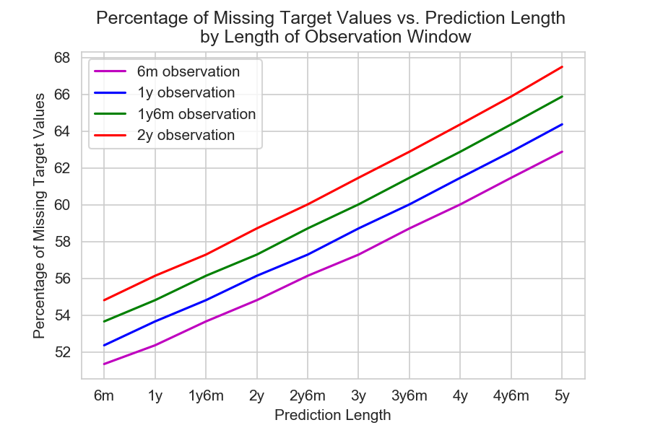
Figure 12: Missing Target Values by Temporal Configuration. Percentage of missing targets for different temporal model configurations (observation window length| prediction length) displayed as line plots representing different observation windows across prediction lengths.

Slide 20
Imputation Methods: Non-EDSS
Non-EDSS Feature Imputation
Forward fill for temporal features
Recorded every 6 months
Change across time
Zero fill for fixed demographic features
Recorded only once
Zero fill for values in temporal features forward fill could not reach
If a missing doesn’t have a previous record in time we cannot use ffill

Slide 21
Imputation Methods: EDSS
EDSS Imputation
Dynamic fill
GRU-DF
Forward fill
GRU-FF
Ridge Regression-FF

Slide 22
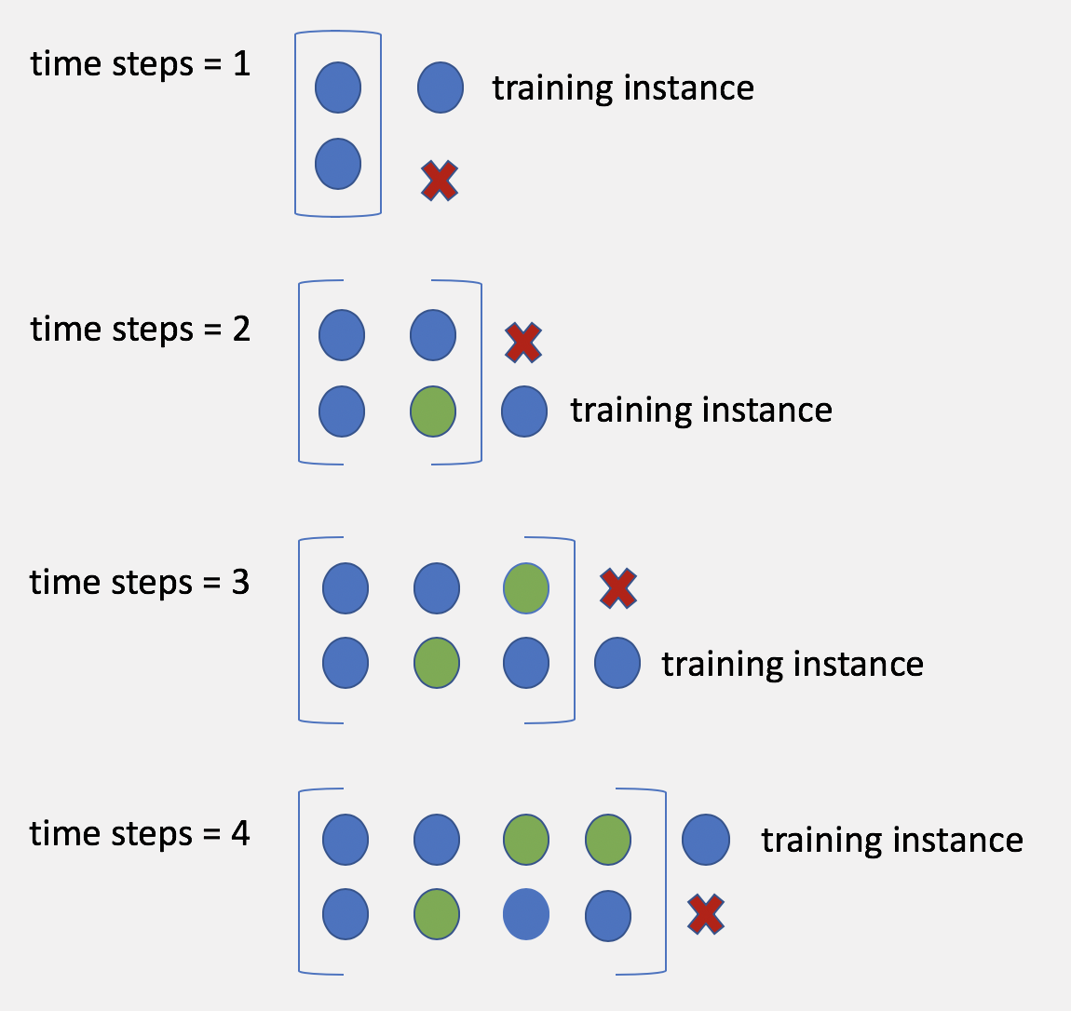
Dynamic Fill
Figure 13: Dynamic Fill Imputation. At each step, training instances are used to learn a model which is used to predict and impute for the missing values. The predictive imputation algorithm moves one time step at a time, running the training operation for a single epoch at each time step, until it reaches the last desired time step where it runs up to 500 epochs coupled with the early stopping and learning rate learner method. All imputed instances get updated at each new iteration of the algorithm, since a new learning model is generated at each time step.

Slide 23
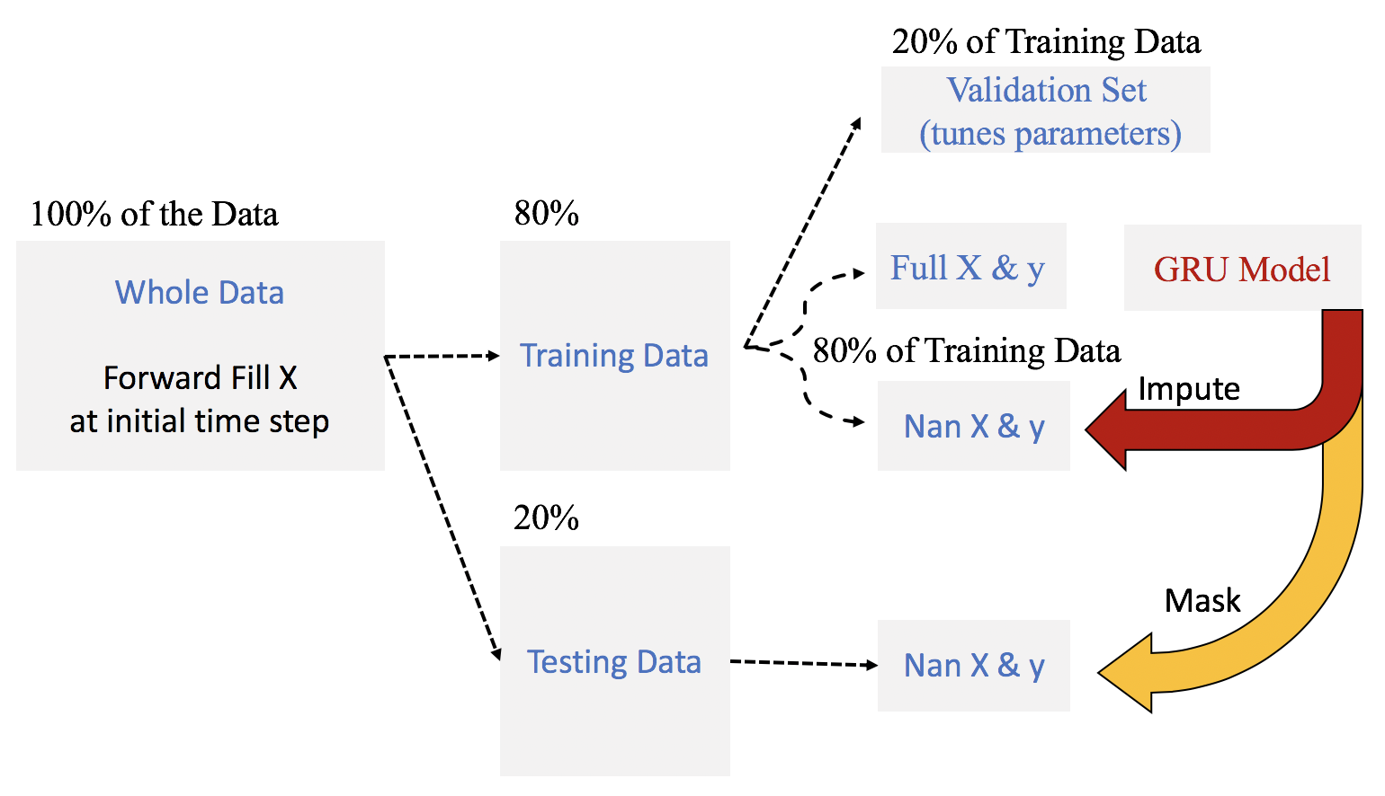
Dynamic Imputation
Figure 14: Dynamic Fill Diagram. Here we see the pipeline for imputing missing values with the dynamic fill approach. Nan refers to missing values.

Slide 24
Imputation Methods: Discarded
Discarded Imputation Methods
Mean Fill
Not suitable for a multivariate time series
Zero Fill for all non-EDSS features
Forward fill for temporal features outperforms this approach

Slide 25
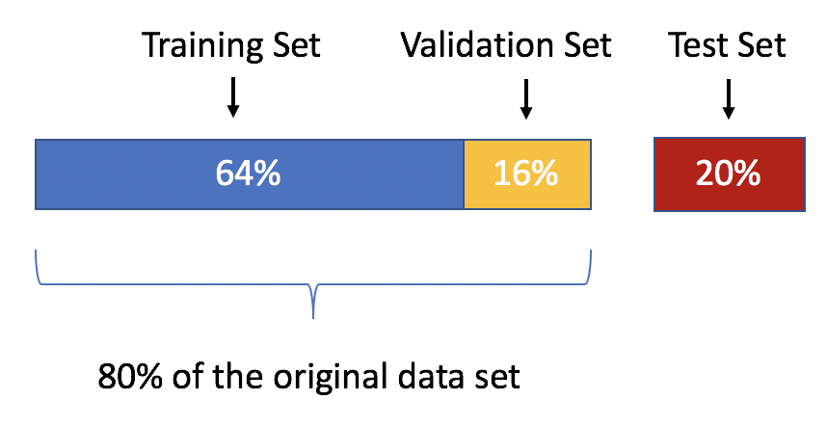
Test Results: 5-Fold CV & Masked Test Results
Figure 15: Cross Validation. Percentages are not relative and are based on the entire data set. The training set is used for learning, i.e. to fit the parameters of the model. The validation set, a subset of the training set, is used to tune model parameters, i.e. to determine the best model weights. The test set is only used to evaluate the model’s performance on unseen data after the training operation is done.

Slide 26
Experimental. Models
Ridge-FF
Non-temporal baseline
GRU-FF
Imputation method baseline
GRU-DF
Temporal Model
Intelligent Imputation

Slide 27
Experimental. Models
Ridge-FF
Non-temporal baseline
GRU-FF
Imputation method baseline
GRU-DF
Temporal Model
Intelligent Imputation

Slide 28
Experimental. Models
Ridge-FF
Non-temporal baseline
GRU-FF
Imputation method baseline
GRU-DF
Temporal Model
Intelligent Imputation

Slide 29
Experimental. Models
Ridge-FF
Non-temporal baseline
GRU-FF
Imputation method baseline
GRU-DF
Temporal Model
Intelligent Imputation

Slide 30
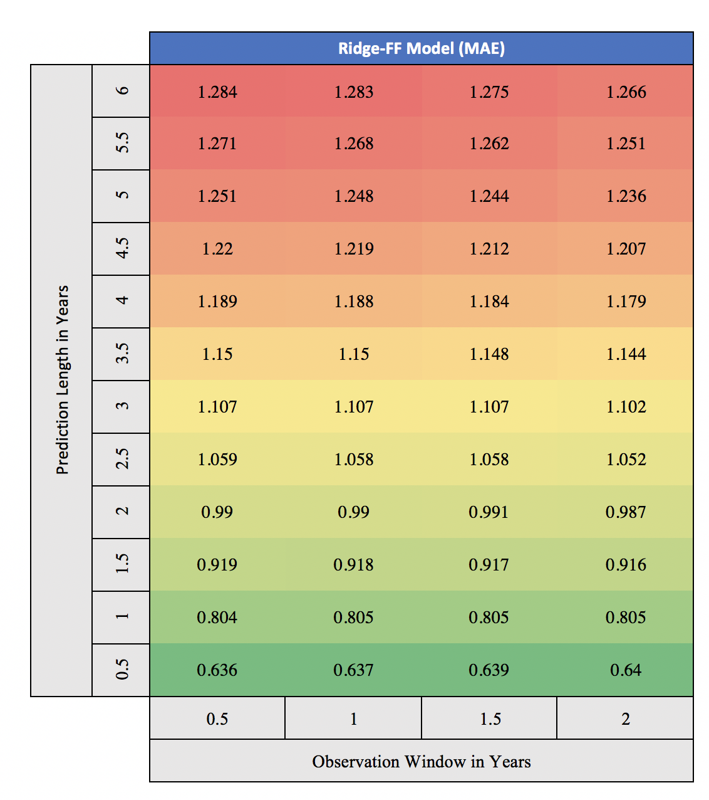
Experimental Results: Ridge-FF

Slide 31
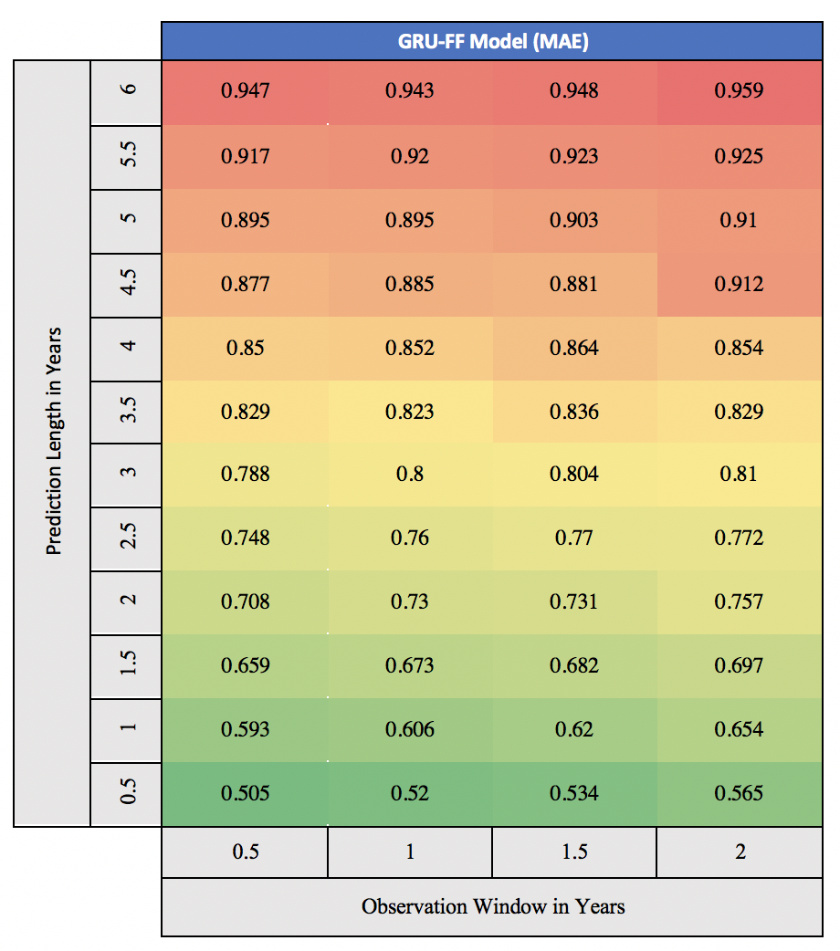
Experimental Results: GRU-FF

Slide 32
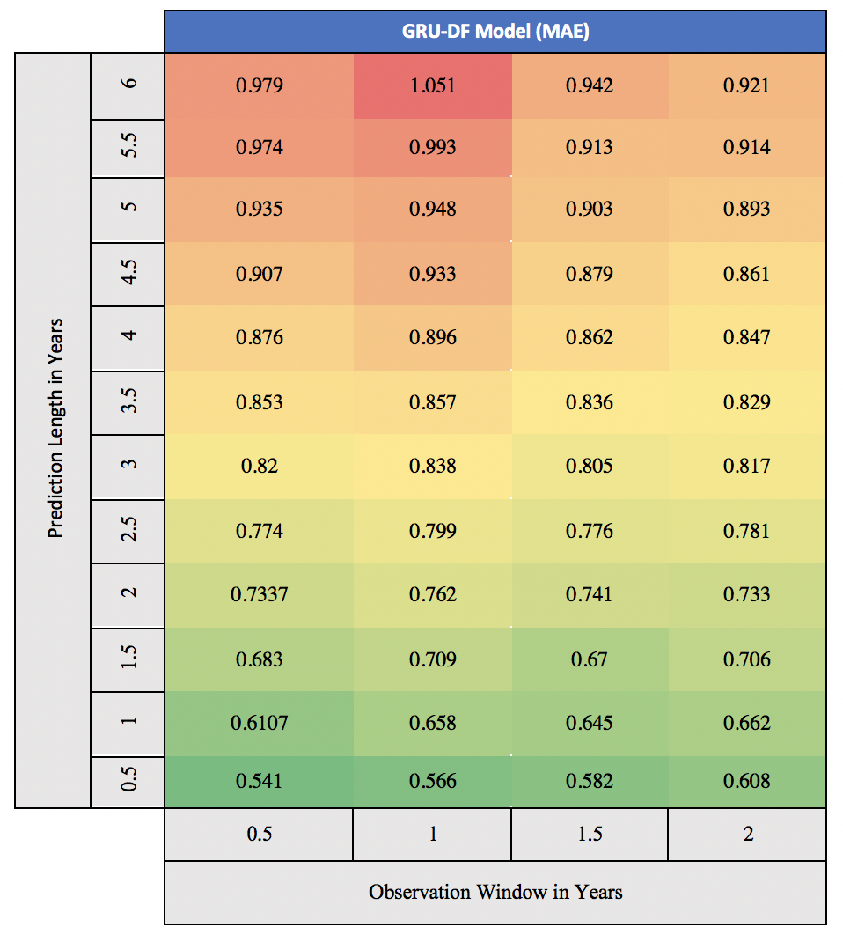
Experimental Results: GRU-DF

Slide 33
Vertical Trend: Negative (As expected)
Not surprisingly
It is harder to predict
farther ahead

Slide 34
Horizontal Trend Varies
Tends to become more positive
as we increase prediction length

Slide 35
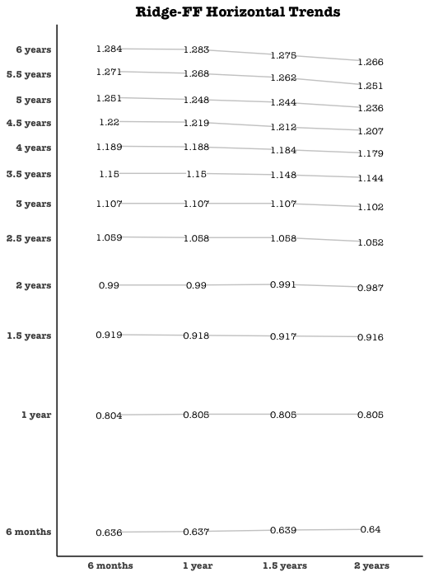
Ridge-FF Horizontal Trend Static to Positive

Slide 36
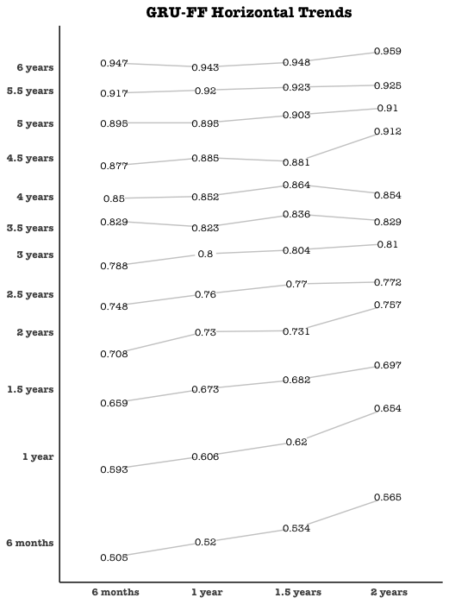
GRU-FF Horizontal Trend Negative to Flat

Slide 37
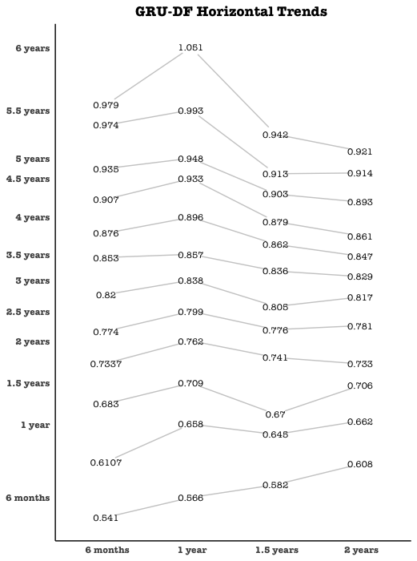
GRU-DF Horizontal Trend Negative to Positive

Slide 38
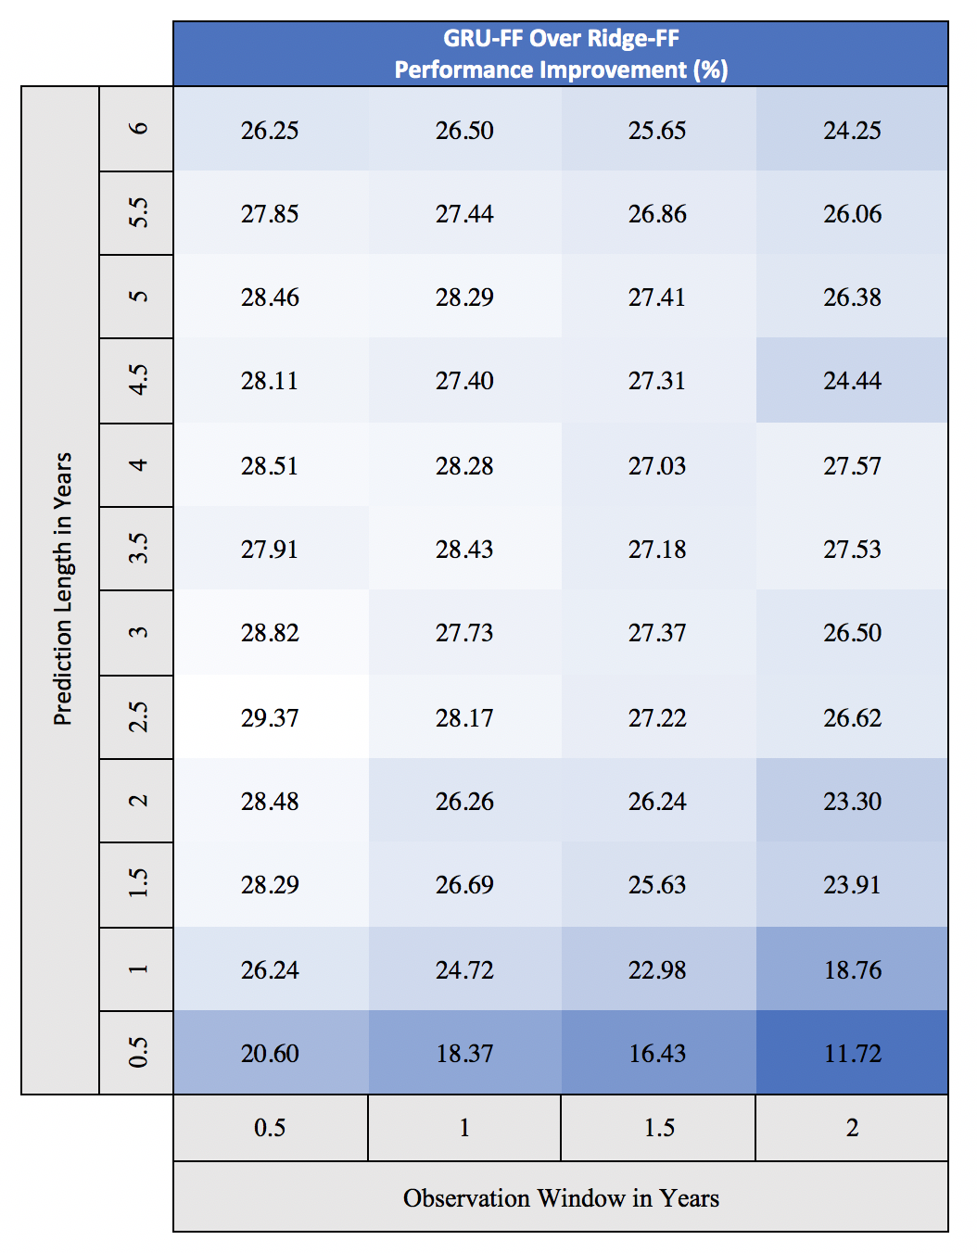
GRU-FF vs Ridge-FF

Slide 39
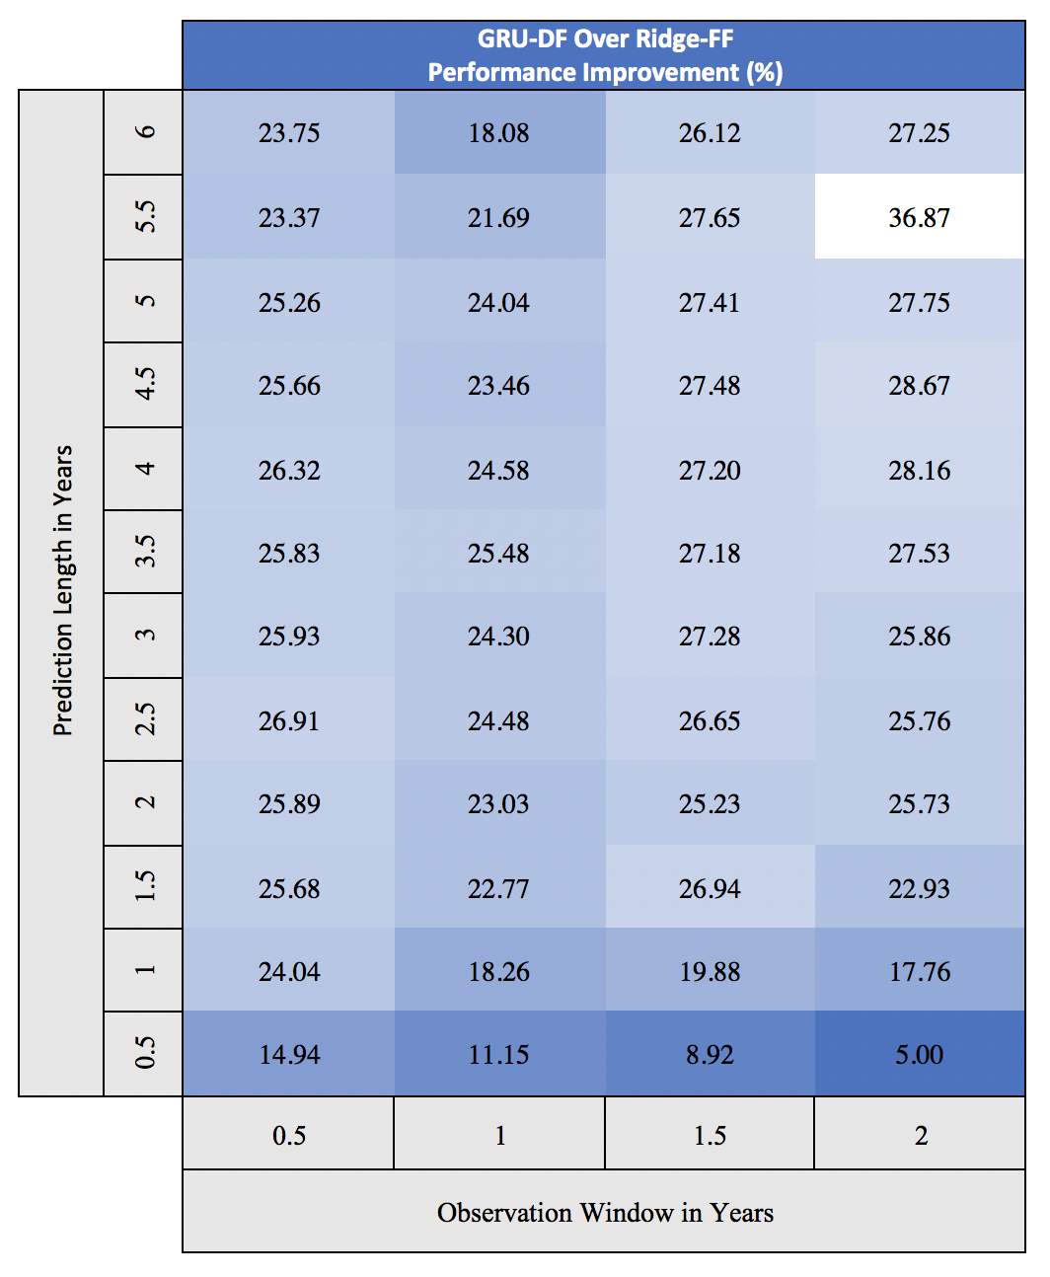
GRU-DF vs Ridge-FF

Slide 40
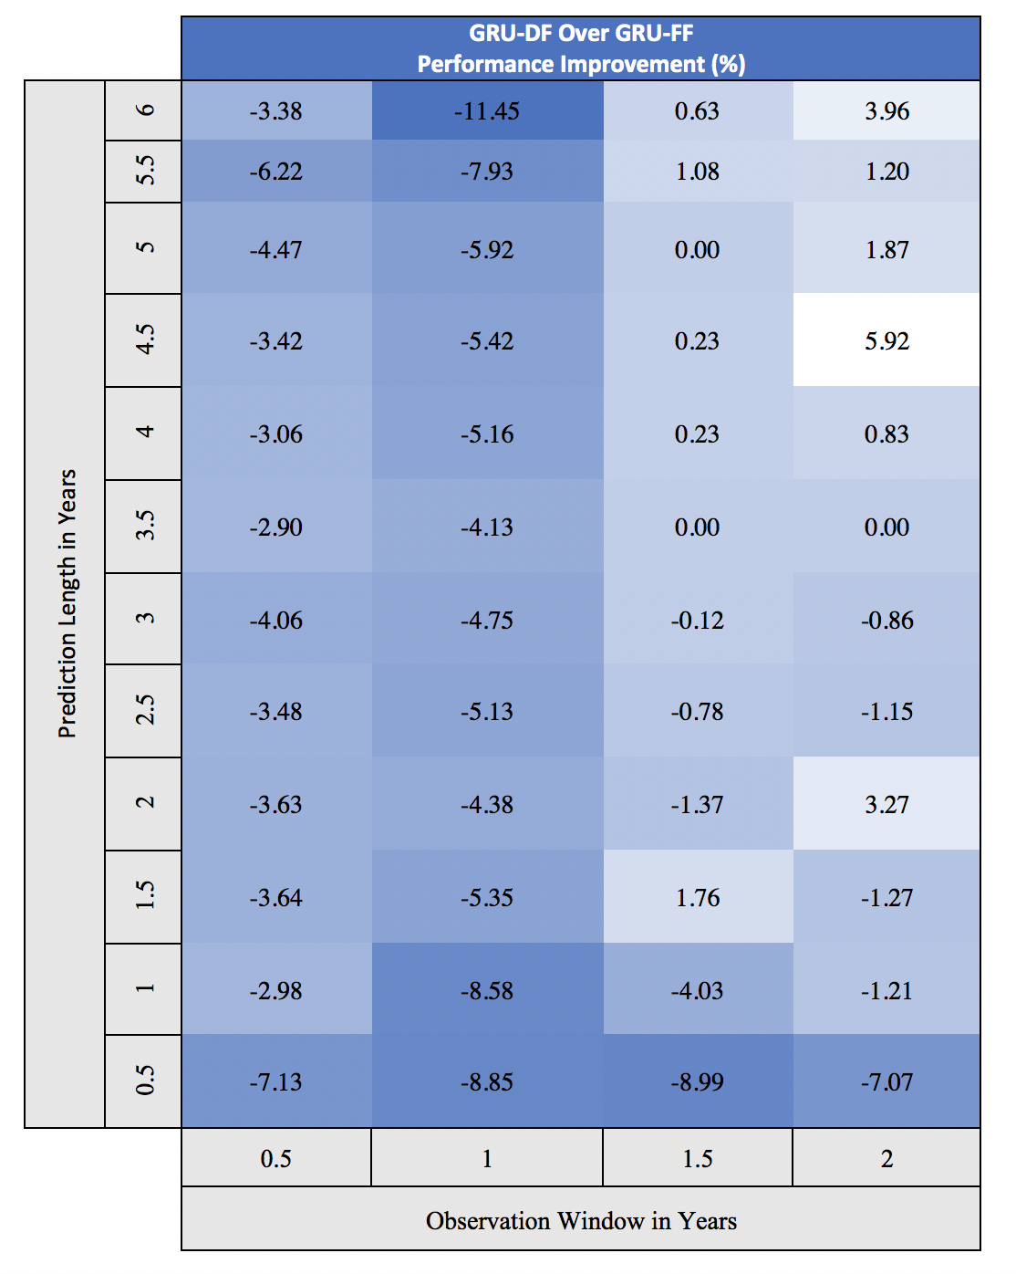
GRU-DF vs GRU-FF

Slide 41
Conclusion
TEMPORAL VS NON-TEMPORAL
Temporal models outperform non-temporal models across the board.
TEMPORAL MODELS (GRU-FF VS GRU_DF)
GRU-DF with a long observation window is superior to GRU-FF at predicting more distant targets, from 3 to 6 years into the future
PATIENT OBSERVATION
Longer observation windows tend to yield better performance for longer predictions.

Slide 42
Conclusion
TEMPORAL VS NON-TEMPORAL
Temporal models outperform non-temporal models across the board.
TEMPORAL MODELS (GRU-FF VS GRU_DF)
GRU-DF with a long observation window is superior to GRU-FF at predicting more distant targets, from 3 to 6 years into the future
PATIENT OBSERVATION
Longer observation windows tend to yield better performance for longer predictions.

Slide 43
Conclusion
TEMPORAL VS NON-TEMPORAL
Temporal models outperform non-temporal models across the board.
TEMPORAL MODELS (GRU-FF VS GRU_DF)
GRU-DF with a long observation window is superior to GRU-FF at predicting more distant targets, from 3 to 6 years into the future.
PATIENT OBSERVATION
Longer observation windows tend to yield better performance for longer predictions.

Slide 44
Conclusion
TEMPORAL VS NON-TEMPORAL
Temporal models outperform non-temporal models across the board.
TEMPORAL MODELS (GRU-FF VS GRU_DF)
GRU-DF with a long observation window is superior to GRU-FF at predicting more distant targets, from 3 to 6 years into the future
PATIENT OBSERVATION
Longer observation windows tend to yield better performance for longer predictions.

Slide 45
Discussion
EDSS Score
Missing data
Subsequences of Missing values

Slide 46
Future Works
Explore alternative measures of MS deterioration
BPF (Brain Atrophy)
Develop GRU-DF to impute for ALL features not just EDSS
This would require a many to many model
We need bigger dataset to achieve

